Slide 1
Browser and JavaScript
JavaScript: Road to AngularJS
Class-1
Jubayer Al Farabi

Slide 2
Agenda
What is frontend development
Understand how browser works
The order of processing scripts and style sheets
Basic HTML and CSS specifications
How JavaScript works

Slide 3
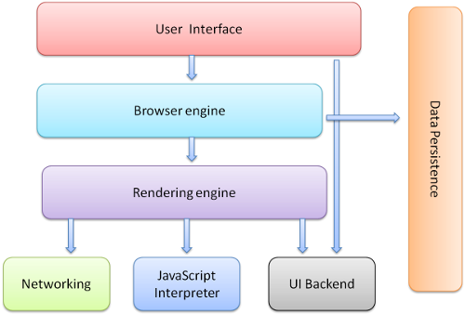
Browser’s High Level Structure
http://www.html5rocks.com/en/tutorials/internals/howbrowserswork/

Slide 4
Browser’s Component
Rendering Engine
Single threaded
Parse HTML and CSS
Display parsed content on the screen
Networking
Network calls such as HTTP requests
Platform-dependent

Slide 5
Browser’s Component
JavaScript Engine
V8 - open source, developed by Google in Denmark, part of Google Chrome. In order to obtain speed, V8 translates JavaScript code into more efficient machine code instead of using an interpreter. It compiles JavaScript code into machine code at execution by implementing a JIT (Just-In-Time) compiler like a lot of modern JavaScript engines such as SpiderMonkey or Rhino (Mozilla) are doing. The main difference with V8 is that it doesn’t produce bytecode or any intermediate code.
Chakra, for Internet Explorer 9^{[16]}
Rhino, Spidermonkey used by Firefox
JavaScriptCore for Apple, Safari
Data storage
This is a persistence layer. Save all sorts of data locally, such as cookies.

Slide 6

Rendering Engine’s Main Flow
Gets content requested document from the network layer
Parses HTML document and converts elements to DOM nodes in a tree.
Parses the style data, both in external CSS files and in style elements
DOM tree and Styling information together with visual instructions in the HTML will be used to create render tree
The next stage is painting–the render tree will be traversed and each node will be painted using the UI backend layer.
Render tree gets coordinates through Layout process

Slide 7
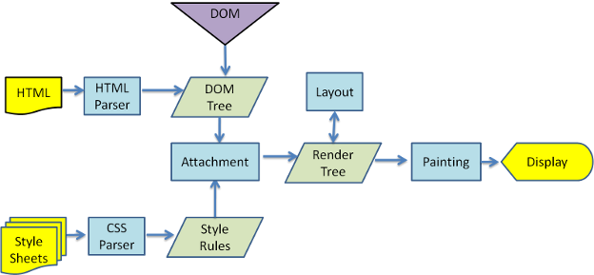
Different Rendering Engines
Different browsers use different rendering engines: Internet Explorer uses Trident, Firefox uses Gecko, Safari uses WebKit. Chrome and Opera (from version 15) use Blink, a fork of WebKit.
Figure: WebKit main flow

Slide 8
HTML Parser
Parse the HTML markup into a parse tree.
The vocabulary and syntax of HTML are defined in specifications created by the W3C organization.
HTML DTD (Document Type Definition): HTML definition is in a DTD format. This format is used to define languages of the SGML family. The format contains definitions for all allowed elements, their attributes and hierarchy.

Slide 9
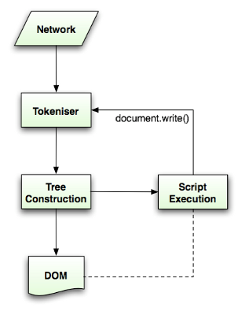
HTML Parser
The algorithm consists of two stages: tokenization and tree construction.
Tokenization is the lexical analysis, parsing the input into tokens. Among HTML tokens are start tags, end tags, attribute names and attribute values.
The tokenizer recognizes the token, gives it to the tree constructor, and consumes the next character for recognizing the next token, and so on until the end of the input.
http://www.whatwg.org/specs/web-apps/current-work/multipage/parsing.html

Slide 10
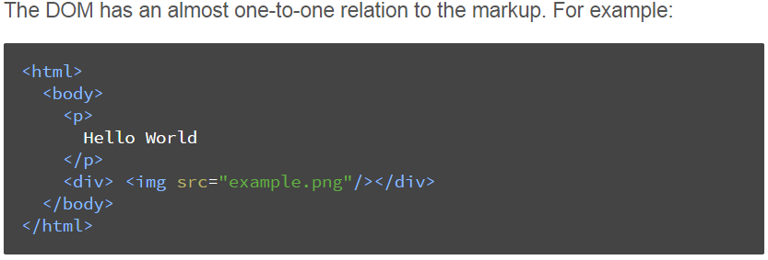
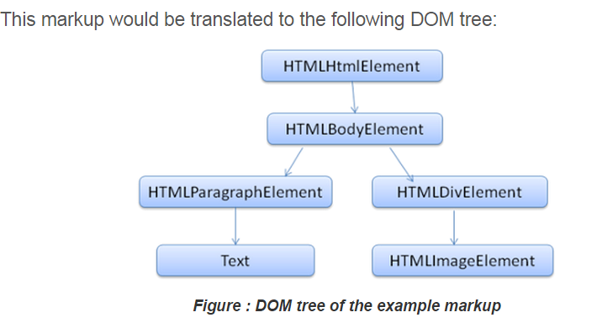
DOM
It is the object presentation of the HTML document and the interface of HTML elements to the outside world like JavaScript.

Slide 11
CSS Parser
Unlike HTML, CSS is a context free grammar. the CSS specification defines CSS lexical and syntax grammar.
CSS file is parsed into a StyleSheet object. Each object contains CSS rules. The CSS rule objects contain selector and declaration objects and other objects corresponding to CSS grammar.

Slide 12
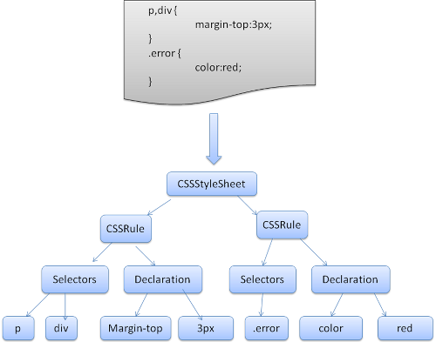
CSS Parser
Figure : parsing CSS

Slide 13
The order of processing scripts and style sheets
Scripts
The model of the web is synchronous. Authors expect scripts to be parsed and executed immediately when the parser reaches a <script> tag. The parsing of the document halts until the script has been executed. If the script is external then the resource must first be fetched from the network–this is also done synchronously, and parsing halts until the resource is fetched. This was the model for many years and is also specified in HTML4 and 5 specifications. Authors can add the "defer" attribute to a script, in which case it will not halt document parsing and will execute after the document is parsed. HTML5 adds an option to mark the script as asynchronous so it will be parsed and executed by a different thread.

Slide 14
The order of processing scripts and style sheets
Speculative parsing
Both WebKit and Firefox do this optimization. While executing scripts, another thread parses the rest of the document and finds out what other resources need to be loaded from the network and loads them. In this way, resources can be loaded on parallel connections and overall speed is improved. Note: the speculative parser only parses references to external resources like external scripts, style sheets and images: it doesn't modify the DOM tree–that is left to the main parser.

Slide 15
The order of processing scripts and style sheets
Style sheets
Style sheets on the other hand have a different model. Conceptually it seems that since style sheets don't change the DOM tree, there is no reason to wait for them and stop the document parsing. There is an issue, though, of scripts asking for style information during the document parsing stage. If the style is not loaded and parsed yet, the script will get wrong answers and apparently this caused lots of problems. It seems to be an edge case but is quite common. Firefox blocks all scripts when there is a style sheet that is still being loaded and parsed. WebKit blocks scripts only when they try to access certain style properties that may be affected by unloaded style sheets.

Slide 16
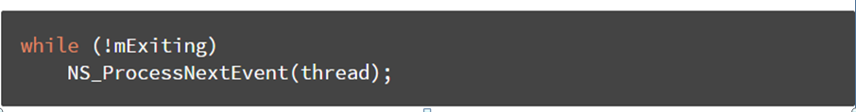
Event Loop
The browser main thread is an event loop. It's
an infinite loop that keeps the process alive. It
waits for events (like layout and paint events)
and processes them. This is Firefox code for the
main event loop:

Slide 17
HTML Basic
Block-level Elements
A block-level element always starts on a new line and takes up the full width available (stretches out to the left and right as far as it can).
Inline Elements
An inline element does not start on a new line and only takes up as much width as necessary.

Slide 18
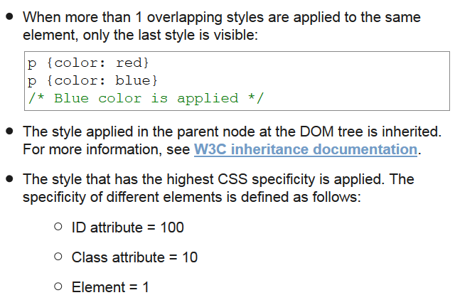
CSS Styling Rule
When creating a CSS document, the following rules apply:
https://www.w3.org/TR/CSS21/cascade.html#inheritance

Slide 19
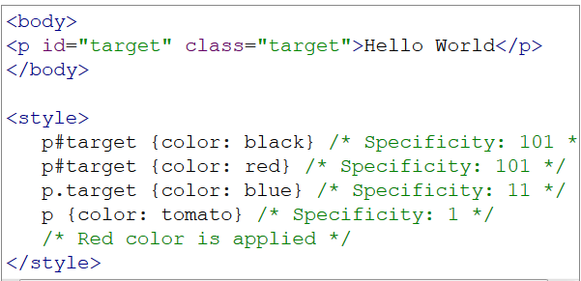
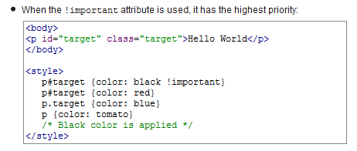
CSS Styling Rule

Slide 20
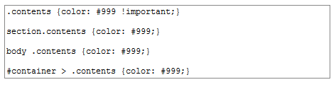
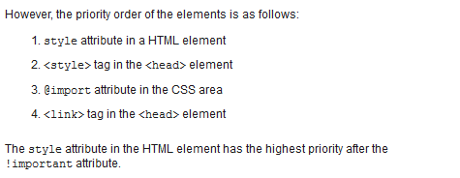
CSS Styling Rule

Slide 21
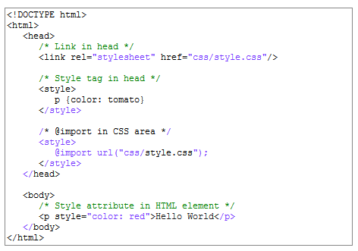
CSS Styling Rule

Slide 22
JavaScript
What we call JavaScript is actually an implementation of the ECMAScript language specification. For JavaScript to be considered a valid version of ECMAScript , it must provide a mechanisms to support syntax and semantics defined in the spec. JS as an implementation must provide the programmer affordances to use the various types, properties, values, functions and reserved words that make up ECMAScript.
JavaScript is most commonly used as a client side scripting language. This means that JavaScript code is written into an HTML page. When a user requests an HTML page with JavaScript in it, the script is sent to the browser and it's up to the browser to do something with it.

Slide 23
Understand JavaScript
Block level and function level scope:
#include <stdio.h>
int main() {
int x = 1;
printf("%d, ", x); // 1
if (1) {
int x = 2;
printf("%d, ", x); // 2
}
printf("%d\n", x); // 1
}
The output from this program is 1, 2, 1. This is because C, and the rest of the C family, has block-level scope.

Slide 24
Understand JavaScript
Guess the output for JS version
var x = 1;
console.log(x); // 1
if (true) {
var x = 2;
console.log(x); // 2
}
console.log(x); // ????
This is radically different from the C family. Blocks, such as if statements, do not create a new scope. Only functions create a new scope.

Slide 25
Understand JavaScript
Guess the output for JS version
var x = 1;
console.log(x); // 1
if (true) {
var x = 2;
console.log(x); // 2
}
console.log(x); // 2
This is radically different from the C family. Blocks, such as if statements, do not create a new scope. Only functions create a new scope.
In this case, Firebug will show 1, 2, 2.

Slide 26
What’s the sequence?
Function declarations: These are of the form, function foo() {}.
Variable declarations: These take the form, var foo;.
Function declarations and variable declarations are always moved invisibly to the top of their containing scope by the JavaScript interpreter. This means that code like this:
function foo() {
bar();
var x = 1;
}
is actually interpreted like this:
function foo() {
var x;
bar();
x = 1;
}

Slide 27
Guess the Output
var foo = 1;
function bar() {
if (!foo) {
var foo = 10;
}
alert(foo);
}
bar();
------------------------------------
var a = 1;
function b() {
a = 10;
return;
function a() {}
}
b();
alert(a);

Slide 28
Guess the Output
var foo = 1;
function bar() {
if (!foo) {
var foo = 10;
}
alert(foo); //10
}
bar();
------------------------------------
var a = 1;
function b() {
a = 10;
return;
function a() {}
}
b();
alert(a); //1

Slide 29
Guess the Output
function test() {
foo(); // TypeError "foo is not a function"
bar(); // "this will run!"
var foo = function () { // function expression assigned to local variable 'foo'
alert("this won't run!");
}
function bar() { // function declaration, given the name 'bar'
alert("this will run!");
}
}
test();

Slide 30
Guess the Output
function test() {
foo();
bar();
var foo = function () { alert("this won't run!");
}
function bar() { alert("this will run!");
}
}
test();
function test() {
var foo;
function bar() { alert("this will run!");
}
foo();
bar(); // "this will run!"
foo = function () { alert("this won't run!");
}
}
test();

Slide 31
Assignment
Solve this problem on JavaScript: (Array Simulation, use separate function for each operations)
inputObject = {
n:5,
nA: [1,2,3,4,5],
m:3,
mA: [
{ op:’p’ , values:[0,1]},
{ op:’s’ , values:[1]},
{ op:’r’ , values:[]}
]
}
Here ‘n’: number of integers in ‘nA’: array, ‘m’: number of operations(object) in ‘mA’: array. For each operation object in ‘mA’ there is ‘op’ : operation name and ‘values’: array . The information about the operations are given below:
1. { op:’s’ , values:[D]}. D is an integer. D will be added with all the elements of the nA array.
2. { op:’m’ , values:[D]}. D is an integer. All the elements of the nA will be multiplied by D.
3. { op:’d’ , values:[K]}. K is a non zero integer. All the elements of the nA will be divided by K (integer division).
4. { op:’r’ , values:[]}. It means reverse. It will reverse the elements of the nA.
5. { op:’p’ , values:[Y,Z]}.Y and Z are integers. It will swap the elements a[Y] and a[Z].
Then print the updated nA on console. For the given inputObject the output is: 6 5 4 2 3
For html Create a form using as much html elements as you can with css that has name, address etc. You can use bootstrap(That’ll be nice). Do it like the best you can do

Slide 32


